Slide 1

NSRIC Inc. (Nature Science Research and Innovation Centre)
Ontario (ON), Canada
Online Education (OE) Division
Consumer Behavior
Instructor: Kathy Chen
Marketing Program, OE Division
NSRIC Inc.
London, ON, Canada
E-mail: kathyjchen18@gmail.com
https://www.nsric.ca

Slide 2
Week 5: Attitudes and Behaviors
Content covered in this week:
3.1 Affects, intended behaviors and cognition
3.2 Measuring attitudes
3.3 Your experience with IAT

Slide 3
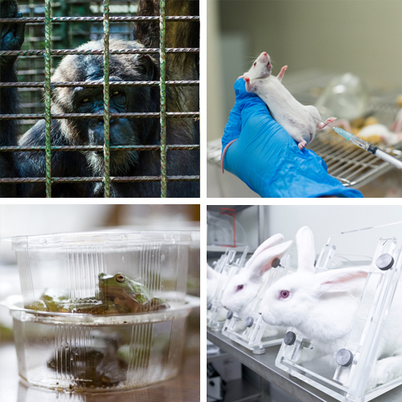
Week 5: Attitudes and Behaviors
3.1 Affects, intended behaviors and cognition
1. What is an attitude?
How can attitudes be changed and how do they impact on our behaviors?
Look at these pictures. How do they make you feel?
You might feel sorry or bad about how these
animals are treated, and this feeling might
translate into donating to a charity or getting
involved in some forms of activism to prevent
this kind of treatment.

Slide 4
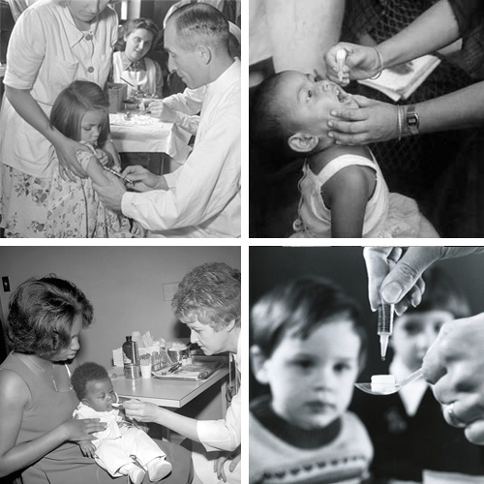
Week 5: Attitudes and Behaviors
3.1 Affects, intended behaviors and cognition
1. What is an attitude?
How can attitudes be changed and how do they impact on our behaviors?
Look at these pictures. How do they make you feel?
However, what do you think about these pictures?
These are classic pictures of polio victims that
have largely been erased from the public
consciousness owing to the development of the
polio vaccine. Albert Sabin says, ‘There could
have been no oral polio vaccine without the use
of innumerable animals.’

Slide 5
Week 5: Attitudes and Behaviors
3.1 Affects, intended behaviors and cognition
Does this change your attitude towards animal testing?
Maybe. Or maybe not. But this is an example of how attitudes can be changed with more persuasive information, and how attitudes can also impact the way we behave.
Attitude
'A learned predisposition to respond in a consistently favorable or unfavorable manner in relation to some object.' (Fishbein and Ajzen, 1975)

Slide 6
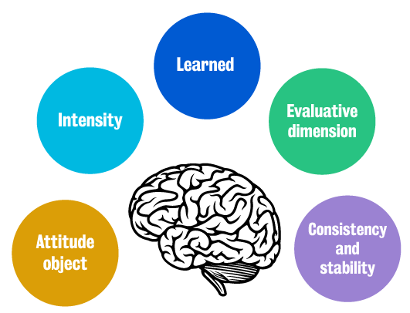
Week 5: Attitudes and Behaviors
3.1 Affects, intended behaviors and cognition
Let’s break down this definition. First of all, we have the evaluative dimension which is the consistently favorable, unfavorable or neutral attitude towards something. Learned through experience, this attitude is consistent and stable unless other persuasive information changes it. Attitudes can also vary in terms of their intensity.

Slide 7
Week 5: Attitudes and Behaviors
3.1 Affects, intended behaviors and cognition
2. Attitudes in psychology and in consumer behavior
What is an attitude in psychology?
People use the word 'attitude' in many different ways, in common life. For example, your mother might have said that she doesn’t like your attitude, but what she was really referring to was your mood or affective state.

Slide 8
Week 5: Attitudes and Behaviors
3.1 Affects, intended behaviors and cognition
The definition of attitude in psychology
For the purposes of this module, you need to remember that, in psychology, an attitude is defined as a valenced expression towards an attitude object.
Therefore, attitudes can be positive, neutral or negative. The expression could be a belief, an opinion, intended action or feeling towards an attitude object
Attitude objects
Attitude objects could be places, people, issues, ideas or anything else that consumers encounter in their lives. For example, you have attitudes towards Burberry, Theresa May, celebrities, smoking, saving money and using electronic devices at home.

Slide 9
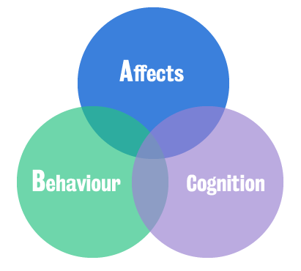
Week 5: Attitudes and Behaviors
3.1 Affects, intended behaviors and cognition
The tri-component model (ABC)
An attitude has three parts:
1 – Affects (A): affects mean feelings and this part of the attitude reflects how we feel about something.
2 – Intended behaviour (B): this controls how we
intend to act toward something.
3 – Cognition (C): it refers to how we think
about something.

Slide 10



Week 5: Attitudes and Behaviors
3.1 Affects, intended behaviors and cognition
Affective
The emotional connection the consumer has with the target object (feelings related to the attitude liking/disliking).
Behavioral
The actions or behaviors associated with the attitude object (the intended action).
Cognitive
The beliefs and thoughts the individual has in relation to the target object.

Slide 11
Week 5: Attitudes and Behaviors
3.1 Affects, intended behaviors and cognition
To summarize, you have feelings, intended actions and thoughts concerning certain brands (for example King’s College, the Ferrari brand, etc.) or behaviors (for example working out or eating salads). These attitudes impact the way we actually behave in the marketplace.
Why are attitudes important for marketing practice?
There are three primary reasons:
Psychographic segmentation tool: This can lead to better marketing strategies that target consumers in their favorable communication media, appropriate distribution channels, the design of specific products or services, and pricing strategies.

Slide 12
Week 5: Attitudes and Behaviors
3.1 Affects, intended behaviors and cognition
3. Common functions of attitudes
Attitudes have many functions. We will look at four common functions of attitudes:
The utilitarian function
The utilitarian function of attitudes speeds up choices. You may be familiar with Maltesers, the chocolatey treat brand. Let’s say, for example, that I really hate Maltesers. So, when I see this brand in stores, I often just pass by without further thought, and if someone asked me to buy this brand, I would immediately refuse. Therefore, the utilitarian function saves cognitive resources and time by acting as a decision heuristic.

Slide 13
Week 5: Attitudes and Behaviors
3.1 Affects, intended behaviors and cognition
The value expressive function
The value expressive function reinforces self-identity. For example, you might think of yourself as a ‘green’ person that wants to be a friend to the environment. Therefore, you will have specific favorable attitudes towards cycling, electric cars or recycling, as well as unfavorable attitudes towards plastics or airplane travel, as all of these reinforce your identity as an environmentally friendly person.
The defense function
This function protects the self from threats and negative feelings. For example, you have favorable attitudes towards personal hygiene activities, such as brushing your teeth, taking showers and wearing deodorant. These attitudes protect yourself from social situations that might have negative outcomes, such as feeling self-conscious or receiving negative comments from others.

Slide 14
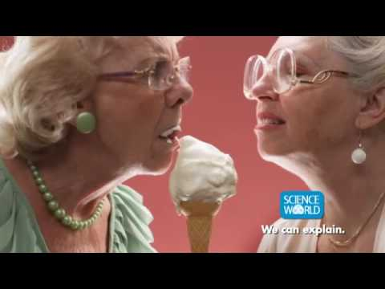
Week 5: Attitudes and Behaviors
3.1 Affects, intended behaviors and cognition
The knowledge function
The knowledge function provides structure, order and meaning to the world around us. This is especially true when you are confronted with a new stimulus.
For example, play the video clip.
The questions on the next page
will be discussed in the seminar

Slide 15
Week 5: Attitudes and Behaviors
3.1 Affects, intended behaviors and cognition
Now that you have watched the video clip, consider the following:
What is this video about and what are they advertising?
What kind of attitude is being activated in your mind?
How are they helping you figure out the purpose of this video?
After considering these questions, please play the rest of the video.
Most students in the past have imagined that the video was about ice cream flavors, deodorant or perfume, or a dating website for elderly people.
Were you surprised that the video was for a Science Museum in Vancouver, Canada? Regardless of the fact that this was the Science Museum, your attitudes help you identify possible reasons for the advertisement.

Slide 16
Week 5: Attitudes and Behaviors
3.2 Measuring Attitudes
Please access this website Harvard's online implicit attitude test
and take one of the Implicit Attitude Tests available there.
Then think about the questions on the next page for in-class discussion.

Slide 17
Week 5: Attitudes and Behaviors
3.3 Your experience with IAT
What was your experience taking the IAT?
How does the result resonate with you and how you feel about the topic?
How can IAT be implemented in market research? Think about a real-world example of this.

